Slide 1
OUTLOOK Hotmail eMail
Session 8
MAR 13-14 7-9 PM, LAB 2
Instructor: Ben Tarbell
Editor: Monna Tarbell
Monitors: BOB MCQUEENEY

Slide 2
WHAT WE WILL COVER
LOGGING IN
READING EMAILS
WRITE, SEND & REPLY
FOLDERS
SPAM & JUNK
CONTACTS
SETTINGS
MISC

Slide 3
Turn your computer on
Button on desktop
Button on monitor
Log into your favorite browser
Log into your email account

Slide 4
SIGN IN TO YOUR EMAIL
USE YOUR FAVORITE BROWSER
INTERNET EXPLORER
MOZILLA FIREFOX
GOOGLE CHROME
USE A SEARCH ENGINE TO GET EMAIL SIGN IN PAGE
WWW.OUTLOOK.COM WWW.MSN.COM
WWW.LIVE.COM WWW.HOTMAIL.COM

Slide 5
AUTOMATICALLY OPEN EMAIL
MAKE YOUR EMAIL A FAVORITE OR BOOKMARK
OPEN EMAIL (IN GOOGLE CHROME)
CLICK STAR
PICK BOOKMARKS BAR
DONE
DO NOT CLICK KEEP ME SIGNED IN CHECK BOX

Slide 6
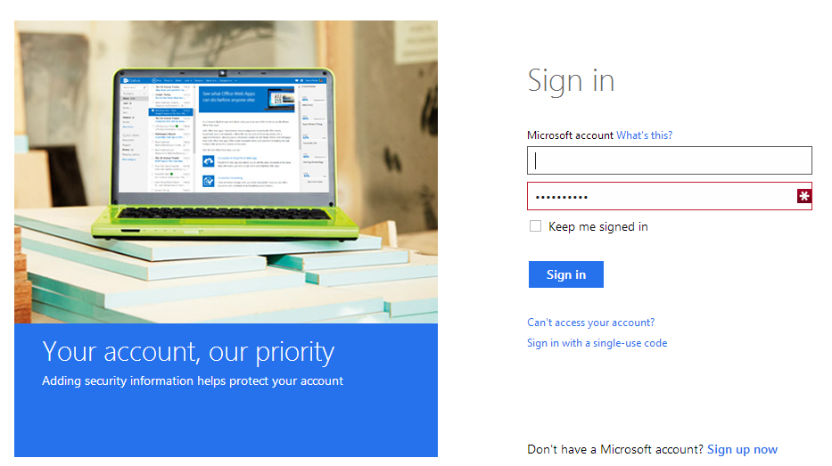
SIGN IN TO MICROSOFT

Slide 7
WHAT DO YOU SEE?
IN BOX WITH NUMBER OF UNREAD EMAILS
CENTER TOP CONTAINS EMAILS
BOTTOM READING PANE IS FOR VIEWING OPENED EMAIL
RIGHT PANE FOR ADVERTISEMENTS
NUMBER OF MESSAGES IN INBOX
UNREAD EMAILS IN BOLD TYPE
READING PANE IS MOVEABLE
CAN USE FULL VIEW TO READ EMAIL

Slide 8
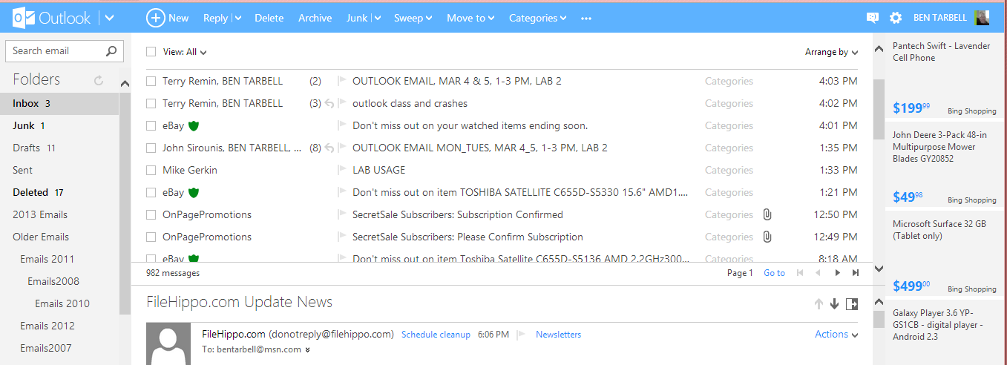
OUTLOOK EMAIL CURRENTLY

Slide 9
IT IS PRACTICE TIME
LET STUDENTS PRACTICE SIGNING IN AND ASK QUESTIONS
Open your email
How many unread emails
Do you have SOME from me?
Hover mouse
Any questions about OPENING OR automatic opening

Slide 10
WHAT WE WILL COVER
LOGGING IN
READING EMAILS
WRITE, SEND & REPLY
FOLDERS
SPAM & JUNK
CONTACTS
SETTINGS
MISC

Slide 11
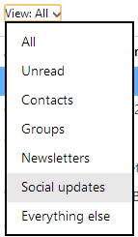
CLICK ARROW BY VIEW ALL

Slide 12
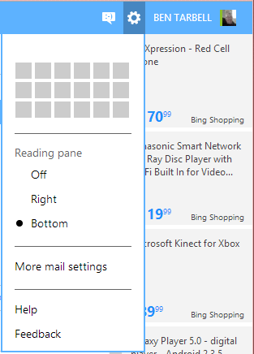
CLICK ON GEAR

Slide 13
opening an email from the inbox
A single left click on the email line will open an email in the lower (viewing) pane.
A double left click on the email line will open an email in the full view.
To switch from the lower (viewing) pane to the full view, left click on “full view”

Slide 14
ONCE IN FULL VIEW
YOU CAN
GO BACK TO MESSAGES (upper right)
ARROW DOWN TO NEXT MESSAGE (if arrow is solid color and you will stay in Full View)
ARROW UP TO PREVIOUS MESSAGE (if arrow is solid color )
IN EACH CASE YOU will stay in Full View)

Slide 15
PREVIEW PANE OPTIONS

Slide 16
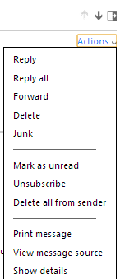
CLICK ACTION ARROW

Slide 17
LETS REVIEW WHAT WE HAVE COVERED
LEFT CLICK TO OPEN AN EMAIL
CLICK ON FULLVIEW
ARROW DOWN/UP TO NEXT/PREVIOUS EMAIL
GO BACK TO INBOX
CLICK TO FORWARD
CLICK TO REPLY

Slide 18
ADJUSTING SIZE OF PREVIEW PANE
DEMONSTRATE
PRACTICE

Slide 19
PREVIEW TO FULL VIEW
REFER BACK TO SLIDE FOR
SINGLE CLICK AND DOUBLE CLICK

Slide 20
OUTLOOK TOOL BAR
TO DEAL WITH OPEN EMAILS

Slide 21
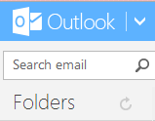
REFRESH YOUR EMAILS

Slide 22
ALL THESE OPTIONS LET YOU DEAL WITH INDIVIDUAL EMAILS EFFICIENTLY
REVIEW THE EMAIL HANDLING OPTIONS ON PREVIOUS SLIDES
PREVIEW PANE ACTIONS LIST
TOOL BAR OPTIONS

Slide 23
LET’S REVIEW
OKAY, LOOK AT AND CLICK ON THESE VARIOUS OPTIONS TO SEE HOW EASY IT IS TO PROCESS OR DEAL WITH AN EMAIL
UP AND DOWN ARROWS
GO OVER GHOST ICONS
ACTIVATE FLAG FOR FOLLOWUP
CLICK DOWN ARROW AFTER REPLY
EXPLAIN TOOLBAR

Slide 24
DELETING EMAILS
When an email has been deleted, it is actually moved to the Deleted folder
Once an individual email is deleted from the “deleted folder” or,
the “deleted folder” is emptied,
there is no second chance to retrieve an email.

Slide 25
WAYS TO DELETE EMAILS
YOU CAN PLACE A CHECK IN THE FRONT BOX AS YOU SCAN/READ EMAILS
TO REMOVE THEM AS A GROUP, CLICK ON “DELETED” LOCATED JUST BELOW LIST OF EMAILS
DELETED EMAILS GO TO THE DELETED FOLDER

Slide 26
WAYS TO DELETE AN INDIVIDUAL EMAIL AS YOU PREVIEW
BY CLICKING EMAIL, THEN
CLICK DELETE IN PREVIEW PANE
SELECT EMAIL CLICK DELETE IN OPTIONS BAR
CHECK IN SQUARE BOX
RIGHT CLICK MOUSE FOR DROPDOWN MENU, LEFT CLICK TO DELETE
PUSH DELETE KEY ON KEYBOARD
OPEN FULLVIEW, CLICK ACTION DOWN ARROW THEN DELETE

Slide 27
DELETE FULLVIEW EMAILS AS YOU READ
CLICK “FULL VIEW” TO OPEN
READ EMAIL, THEN DELETE
USING ONE OF THE AFORE MENTIONED DELETE OPTIONS
NEXT EMAIL OPENS IN “FULL VIEW”
CONTINUE TO READ/DELETE

Slide 28
UN-DELETING (RESTORING) A DELETED EMAIL
LEFT CLICK ON THE DELETED FOLDER (LEFT COLUMN) THIS WILL DISPLAY ALL THE EMAILS YOU HAVE DELETED
LEFT CLICK ON ONE TO RESTORE
CLICK ON MOVE TO IN TOOL BAR
PICK FOLDER WITH LEFT CLICK

Slide 29
PRINTING AN EMAIL
SELECT EMAIL BY LEFT CLICKING ON IT
CLICK TO READ IN “FULL VIEW“
THEN CLICK ON PRINTER IN ***
ACTIONS
- RIGHT CLICK, SELECT PRINT

Slide 30
REFRESH YOUR EMAILS
YOU CAN CLICK ON INBOX
OR YOU CAN CLICK THE “REFRESH” BUTTON
OR CLICK THE F5 KEY

Slide 31
CLICK ARROW BY “CATEGORIES” TO ADD CATEGORIES TO EMAILS

Slide 32
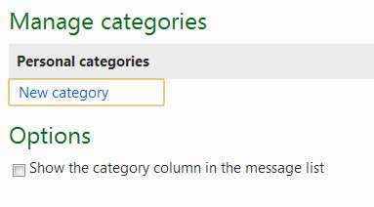
CAN MANAGE CATEGORIES
CLICK ON MORE OPTIONS - MANAGE CATEGORIES

Slide 33
LET’S REVIEW AGAIN
Reading emails
Delete emails
Move to
Categories
Printing an email
Refresh inbox
Make a new folder

Slide 34
eMail Search box
REGULAR SEARCH

Slide 35
HOW TO DOWNLOAD FILES ATTACHED TO AN EMAIL
CLICK ON PAPERCLIP

Slide 36
OPENING AN ATTACHMENT
THE “PAPERCLIP” INDICATES AN ATTACHMENT
DOUBLE CLICK ON THE PAPERCLIP TO OPEN THE ATTACHMENT
VIEW ONLINE/DOWNLOAD
-- VIEW ATTACHMENT: DOCUMENT/PICTURE
ONCE OPEN (DOWNLOADED) -YOU CAN SAVE ATTACHMENT TO YOUR HARDDRIVE

Slide 37
MORE REVIEW
Search Box
Email from Instructor with attachment
Open/Download attachments

Slide 38
WHAT WE WILL COVER
LOGGING IN
READING EMAILS
WRITE, SEND & REPLY
FOLDERS
SPAM & JUNK
CONTACTS
SETTINGS
MISC

Slide 39
IDENTIFY PARTS OF NEW EMAIL
CLICK NEW ON TASK BAR
1-from email account (Automatically ENTERED)
2-to email recipients (cursor blinks HERE)
3-cc and bcc – NEED TO PULL DOWN CC
4-CLICK OPTIONS TO GET BCC
5- ADD A subject line
6-ATTACH FILES-attachments/docs/photos
7-formatting bar-(hover mouse on each)
8-email body- type your message here
9-Signature section (OPTIONAL)

Slide 40
ADDING RECIPIENTS TO YOUR EMAIL
VARIOUS WAYS
TYPE IN EMAIL ADDRESS
WHEN YOU START TYPING THE COMPUTER WILL START SHOWING MATCHES FROM YOUR CONTACT LIST
CLICK “TO” BUTTON TO DISPLAY CONTACTS LIST
Scroll down -CLICK ON ONE YOU WANT
REPEAT FOR ADDITIONAL RECIPIENTS

Slide 41
USING Cc AND Bcc
click on “Show Cc & Bcc” in upper right corner
THE “Cc” (CARBON COPY) FIELD
CAN ENTER CONTACT(S) JUST LIKE “TO”
THESE PEOPLE GET COPIES (NOT EXPECTED TO REPLY)

Slide 42
USING Bcc
THE “Bcc” (BLIND CARBON COPY) FIELD
CAN ENTER CONTACT(S) JUST LIKE “TO” AND “CC”
The primary recipients of your email will NOT know that “Bcc” got a copy of the email.

Slide 43
TIP
When you want to make sure something gets followed up on, always Bcc yourself on new emails to have a copy of the email coming into your “IN” box.
Then you can put a flag on it

Slide 44
NEW EMAIL SUBJECT LINE
SHORT,
DESCRIPTIVE,
HELPS TRACK CONVERSATION

Slide 45
CUT - COPY - PASTE
The Cut, Copy, and Paste commands work as expected, like in any other text editor: select the text and then copy or cut; click with your cursor where you want to make the insertion.
point in your email body to paste text.

Slide 46
ADDITIONAL FORMATTING

Slide 47
REVIEW AGAIN
Reply to one EMAIL I sent you
Add cc and bcc
Add message
Send
Add to Contact List (IF ASKED)

Slide 48
CONVERSATIONS
WITH CONVERSATION SETTING “ON” ALL EMAILS WITH THE SAME SUBJECT LINE WILL BE LINKED TOGETHER SO YOU CAN SEE THE “STRING OF EMAILS”
EACH NEW EMAIL SUBJECT CAN BE THE BEGINNING OF A “CONVERSATION”

Slide 49
SETTING UP CONVERSATIONS
LEFT CLICK GEAR, “MORE MAIL SETTINGS”
….THERE IS A SETTING ON LEFT SIDE
Reading email
Third item –group by conversation

Slide 50
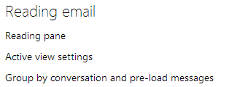
SET UP CONVERSATIONS

Slide 51
ATTACHMENTS TO EMAILS

Slide 52
TIP- WHERE IS MY ATTACHMENT?
PRE-LOCATE THE DOCUMENT, PHOTO, ETC. THAT YOU WANT TO ATTACH AND
PUT A COPY (Do NOT move the original file) OF IT ON THE DESKTOP WHERE IT IS EASIER TO FIND
AFTERWARDS, YOU CAN DELETE THE “COPY” FROM DESKTOP
SOMETIMES GOOD TO MENTION IN BODY OF EMAIL THAT THERE IS AN ATTACHMENT TO THE EMAIL
THAT WAY THE RECIPIENT WILL KNOW TO LOOK FOR IT

Slide 53
ATTACHMENTS
CLICKING ATTACH FILES WILL OPEN A LIBRARY OF DOCUMENTS FOR YOU TO CHOOSE THE ONE YOU WANT TO ATTACH.
LOCATE ITEM/YOUR DESKTOP/LIBRARIES
LEFT CLICK TO HIGHLIGHT THE ITEM YOU WANT TO ATTACH
DOUBLE CLICK TO ATTACH TO EMAIL
IN FREE OUTLOOK FILE SIZE LIMIT IS NO LIMITED
FOR MULTIPLE ATTACHMENTS, REPEAT

Slide 54
ATTACH PHOTO
SIMILAR PROCEDURE
MAY GET A STATUS CHART TELLING YOU OF PROGRESS OF THE UPLOAD TO ATTACH PHOTO/MOVIE TO THE EMAIL

Slide 55
ADD A SIGNATURE TO YOUR EMAIL
MANUAL SINGLE SIGNATURE
CAN HAVE MULTIPLE SIGNATURES,
CAN SET UP AUTOMATIC SIGNATURE,
GEAR, MORE MAIL SETTINGS
MESSAGE FONT AND SIGNATURE – CREATE YOUR OWN
Reference signature on email sent to you

Slide 56
SEND YOUR NEW EMAIL
Take a moment to read and review what you are about to send
CLICK “SEND” BUTTON
OR SAVE DRAFT (OPTIONAL)
OR RICH TEXT (OPTIONAL)
SET PRIORITY (OPTIONAL)

Slide 57
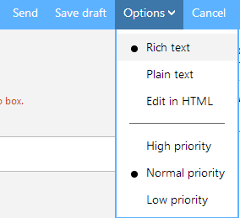
SEND/SAVE DRAFT/OPTIONS

Slide 58
WHAT IS RICH TEXT
Rich Text Format (RTF) is a file format that lets you exchange text files between different word processors in different operating systems.

Slide 59
SENDING EMAIL
ONCE DONE ADDING RECIPIENT(S) , SUBJECT LINE, EDITING, ATTACHING, CLICK SEND.
EMAIL DOES THREE THINGS:
1-COPY SENT TO “SENT” FOLDER
2-COPY SENT TO ALL RECIPIENTS IN “TO”, “CC” & “BCC”
3-GIVES YOU CONFIRMATION IT WAS SENT

Slide 60
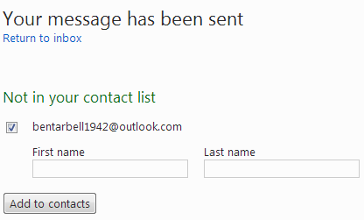
ONCE EMAIL IS SENT YOU WILL BE PROMPTED TO ADD RECIPIENT AS NEW CONTACT

Slide 61
NOTE
IT IS NOT POSSIBLE TO RECALL AN EMAIL MESSAGE YOU HAVE SENT THROUGH OUTLOOK
BEST TO ONLY SEND YOUR EMAIL AFTER PROOF- READING!!!
UsE spell-check
MISSPELLED WORDS WILL HAVE RED UNDERLINE-RIGHT CLICK-CHOOSE CORRECT ONE

Slide 62
REPLY TO AN EMAIL
WHEN YOU CLICK ON REPLY TO AN EMAIL, HOTMAIL AUTOMATICALLY FILLS IN THE “TO” WITH EMAIL ADDRESS , AND
USES SAME “TITLE” ADDING “RE:” FOR REPLY.

Slide 63
REPLY TO AN EMAIL -2
WHEN YOUR REPLY MESSAGE IS COMPLETE,
CLICK “SEND”
YOUR REPLY GOES TO ORIGINAL SENDER
COPY GOES IN SENT FILE
REPLY ALL WILL MAKE SURE EVERYONE IS UPDATED

Slide 64
_{FORWARD}
SENDS AN EMAIL YOU RECEIVED TO SOMEONE NEW.
AT THE RECEIVING END THE EMAIL SUBJECT LINE WILL HAVE “FW:” IN FRONT OF THE SUBJECT.
[FW = FORWARDED]

Slide 65
EMAIL ETIQUETTE WHEN FORWARDING
DO NOT FORWARD ALL THE EMAIL ADDRESSES ON EMAILS THAT HAVE BEEN FORWARDED TO YOU. IF YOU DO YOU ARE JUST GIVING THE HACKERS AMMUNITION TO GRAB A LOT OF EMAIL ADDRESSES AND USE THEM IN A BAD WAY.

Slide 66
REMOVE ADDRESSES
HIGHLIGHT ALL THE EMAIL ADDRESSES AND PUSH ENTER (OR DELETE) TO DELETE SELECTED EMAIL ADDRESSES ON THE ORIGINAL EMAIL
YOU HAVE TO HAVE ALREADY SELECTED REPLY OR FORWARD TO DO THIS
THAT WAY YOU WILL NOT FORWARD EVERY ADDRESS RECEIVED ON TO SOMEONE ELSE.
DEMONSTRATE THIS
OPEN EMAIL INSTRUCTOR SENT YOU

Slide 67
LET STUDENTS PRACTICE
YOU MAY PRACTICE NOW
RETURN An email to me bentarbell@msn.com
Add an attachment/picture

Slide 68
WHAT WE WILL COVER
LOGGING IN
READING EMAILS
WRITE, SEND & REPLY
FOLDERS
SPAM & JUNK
CONTACTS
SETTINGS
MISC

Slide 69
CLICKING ON BLACK ARROWS
DEMONSTRATE VIEWING MORE FOLDERS ON THE LEFT
CLICKING ON RIGHT POINTING ARROWS WILL EXPAND
CLICKING ON DOWN ARROWS WILL CONTRACT

Slide 70
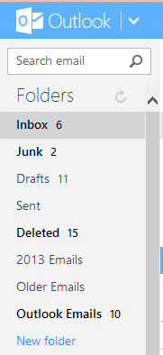
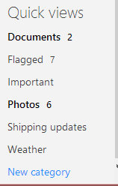
LEFT SIDE FOLDERS EVERYONES WILL BE DIFFERENT

Slide 71
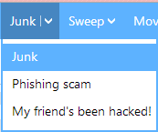
JUNK OPTION

Slide 72
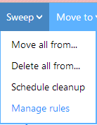
SWEEP OPTION

Slide 73
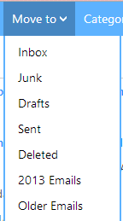
MOVE TO OPTION
MINE HAS EXTRA FOLDERS BY THE YEAR FOR FILING AWAY EMAILS I WANT TO KEEP
AT END IS NEW FOLDER CAPABILITY

Slide 74
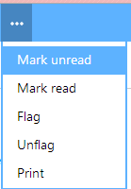
ADDITIONAL OPTIONS (***)

Slide 75
OTHER FOLDER OPTIONS
CREATE NEW FOLDER(S)
RENAME A FOLDER
EMPTY A FOLDER
DELETE A FOLDER
DEMONSTRATE THESE

Slide 76
WHAT WE WILL COVER
LOGGING IN
READING EMAILS
COMPOSE & SEND & REPLY
FOLDERS
SPAM & JUNK
CONTACTS
SETTINGS
MISC

Slide 77
OUTLOOK MANAGES SPAM
BY AUTOMATICALLY HIDING IMAGES, HOTMAIL PREVENTS SPAMMERS FROM KNOWING THEIR EMAILWAS OPENED (NO FEEDBACK).
OUTLOOK WILL NOT DISPLAY IMAGES IN OR ATTACHED TO EMAILS YOU RECEIVE FROM SENDERS THAT ARE NOT IN YOUR CONTACT LIST
OR MARKED AS SAFE SENDERS (UNLESS YOU AUTHORIZE).

Slide 78
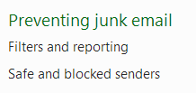
EMAIL SETTINGS
UNDER GEAR, MORE MAIL SETTINGS, CAN SET JUNK EMAIL FILTERING

Slide 79
FILTERS AND REPORTING
CHOOSE A JUNK EMAIL FILTER
STANDARD
EXCLUSIVE
REPORT JUNK MESSAGES
BLOCK CONTENT FROM UNKNOWN SENDERS

Slide 80
GET A OUTLOOK EMAIL ALIASES
Microsoft says you can select just five Outlook aliases a year (an anti-spam and anti-hoarding restriction), so choose wisely. And be quick!
Get the Outlook email address you want before someone else does.

Slide 81
MARK EMAIL AS JUNK
HOVER MOUSE OVER JUNK OPTION TO SEE THIS MESSAGE “MARK A SENDER AS UNSAFE AND DELETE THE MESSAGE”.
CLICKING JUNK WILL MOVE IT TO THE JUNK FILE, MARK SENDER UNSAFE AND DELETE FROM IN BOX.
Junk email is automatically moved into the junk email folder, where it is deleted after ten days.

Slide 82
UNSUBSCRIBE
To remove yourself (your email address) from this mailing list, just click on the blue "Unsubscribe" link (as shown on the screenshot).
Go all the way to the bottom of the email.

Slide 83
WHAT WE WILL COVER
LOGGING IN
READING EMAILS
WRITE, SEND & REPLY
FOLDERS
SPAM & JUNK
CONTACTS
SETTINGS
TIPS

Slide 84
CONTACTS
1-YOU CAN IMPORT CONTACTS FROM ANOTHER EMAIL PROGRAM
REFER TO TUTORIAL AT END
2-YOU CAN ENTER CONTACTS DIRECTLY

Slide 85
CONTACTS -2
ADD A NEW CONTACT CLICK NEW

Slide 86
FILL IN INFORMATION CLICK SAVE INCLUDE ONLY MINIMUM INFO

Slide 87
MANAGING CONTACTS
CONTACTS CAN BE IMPORTED FROM ANOTHER EMAIL PROGRAM
IE, YAHOO TO OUTLOOK
GMAIL TO OUTLOOK

Slide 88
WHAT WE WILL COVER
LOGGING IN
READING EMAILS
COMPOSE & SEND & REPLY
FOLDERS
SPAM & JUNK
CONTACTS
SETTINGS
MISC

Slide 89
PATH TO SETTINGS
CLICK ON GEAR BY YOUR NAME
CLICK ON MORE MAIL SETTINGS

Slide 90
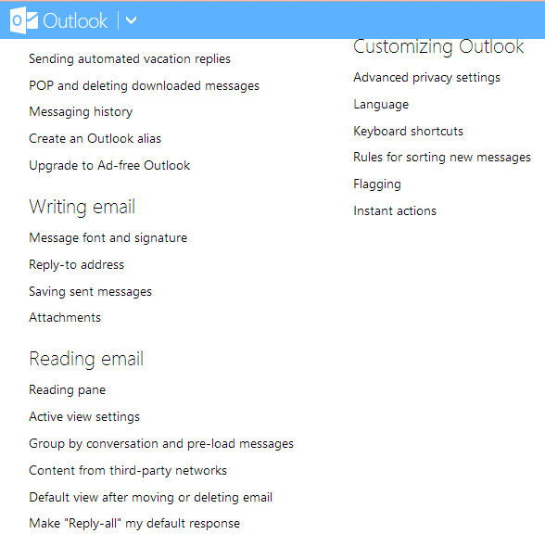

Slide 91
WHAT WE WILL COVER
LOGGING IN
READING EMAILS
WRITE, SEND & REPLY
FOLDERS
SPAM & JUNK
CONTACTS
SETTINGS
Misc

Slide 92
Where is Hotmail eMail help located?
http://www.freeemailtutorials.com/windowsLiveMail/meetWindowsLiveMail/index.htm
NOTICE TOPICAL LIST IN LEFT COLUMN STARTING ON PAGE 2.
USE SEARCH BAR TO FIND YOUR TOPIC
http://windows.microsoft.com/en-US/hotmail/hotmail-help
Ben just sent you an email containing these two links that you can click on.

Slide 93
Add another email account in Windows Live Mail
AMail
Under Options, More Options,
Sending/receiving email from other accounts

Slide 94
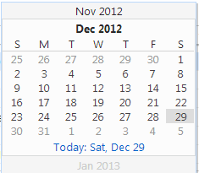
CLICK “GO TO”
OPENS A CALENDER
ALLOWS YOU TO SELECT A DATE TO SEE EMAILS FROM A PARTICULAR DATE

Slide 95
DID I EXPLAIN FUNNY FACE TO THE LEFT OF GEAR AND MY NAME?
Opens Messenger
Themes
Privacy Settings
Account
Options
Can sign into other email accounts

Slide 96
What do these symbols mean?

Slide 97
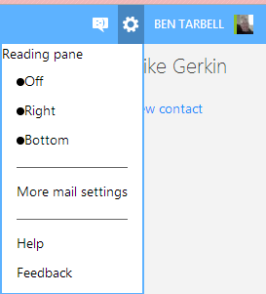

Slide 98
WHEN HELP OPENS

Slide 99
THE END

Slide 100
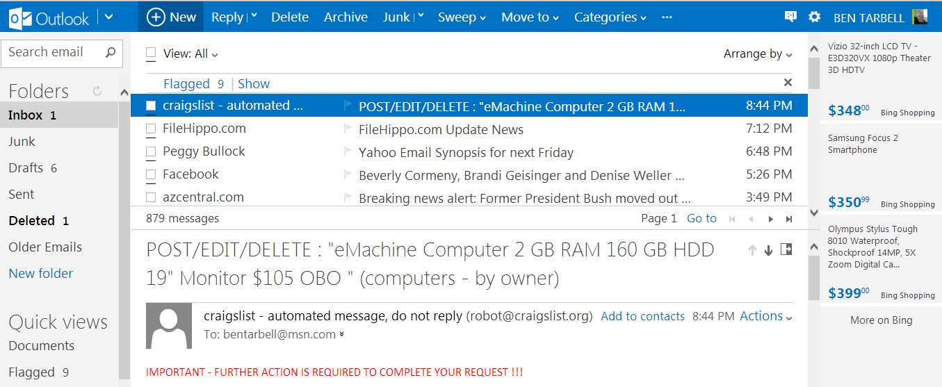
OUTLOOK EMAIL VERSION

Slide 101
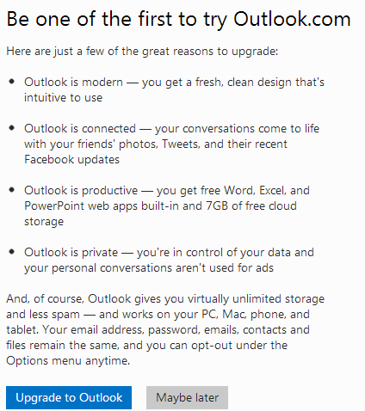
REASONS TO USE OUTLOOK

Slide 102
THE CLASSIC VERSION OF HOTMAIL

Slide 103
HOTMAIL VS OUTLOOK
YOU CAN SWITCH BETWEEN HOTMAIL AND OUTLOOK ANYTIME
DISPLAY OPTIONS ARE DIFFERENT

Slide 104
SIGN UP FOR NEW HOTMAIL ACCOUNT

Slide 105
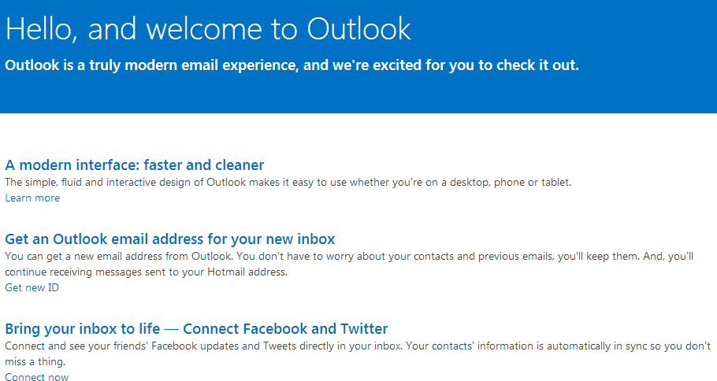

Slide 106
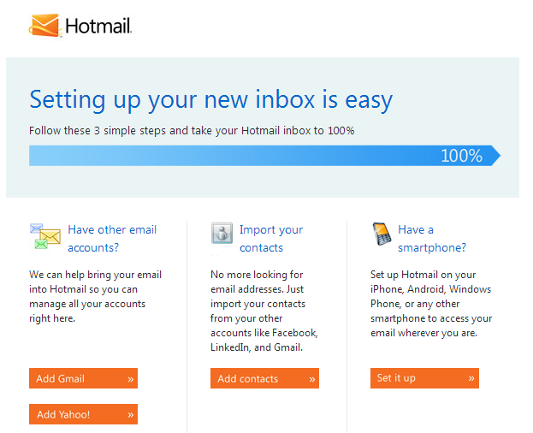
HELP TO SET UP NEW ACCOUNT

Slide 108
SAVE YOUR BOOKMARKS TO HTML

Slide 109
HELP TOPICS
ACCOUNT TEMPORARILY BLOCKED
HACKED ACCOUNT
FORGOTTEN PASSWORD
OTHER PROBLEMS SIGNING IN
RESTORE DELETED EMAIL MESSAGES
ACTIVE VIEWS IN HOTMAIL INBOX
SEND AND RECEIVE EMAIL FROM OTHER EMAIL ACCOUNTS
SHARE PHOTOS AND FILES
ORGANIZE YOUR INBOX
OPTIMIZE INTERNET EXPLORER FOR HOTMAIL

Slide 110
OCCASIONAL LOG IN PROBLEMS

Slide 111
WE WILL POINT OUT A FEW
Account details (password, aliases, time zone)- NOTICE IT MADE YOU LOG IN AGAIN FOR SECURITY. YOU CAN CHANGE YOUR PASSWORD HERE
Message font and signature- SET FONT AND ENTER EMAIL SIGNATURE
Flagging-SHOW FLAGGED MESSAGES AT TOP OF EMAIL LIST. ALTERNATIVELY YOU CAN HIDE FLAGGED ITEMS

Slide 112
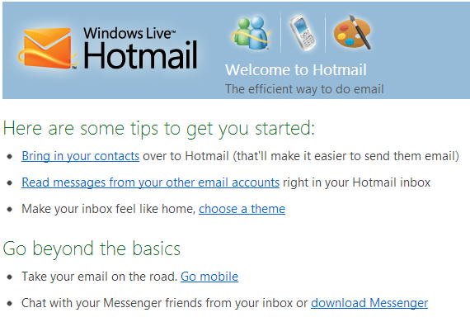

Slide 113
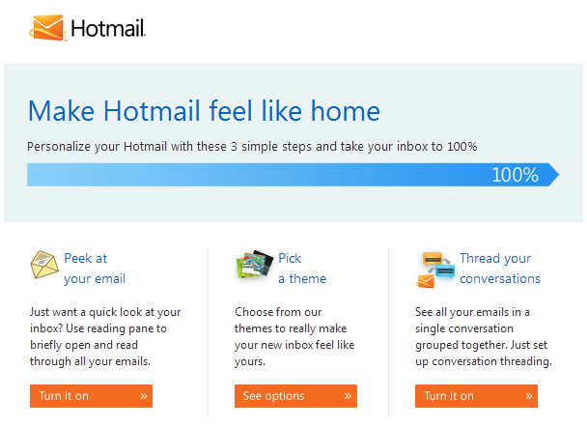

Slide 114
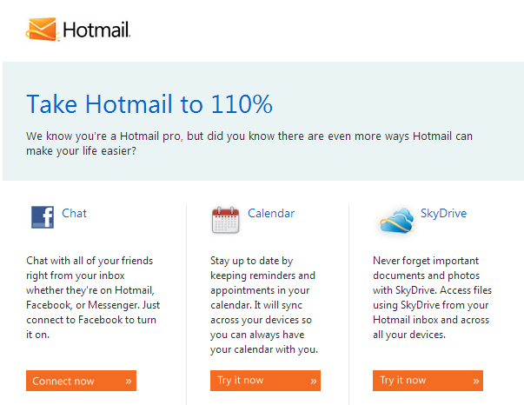

Slide 115
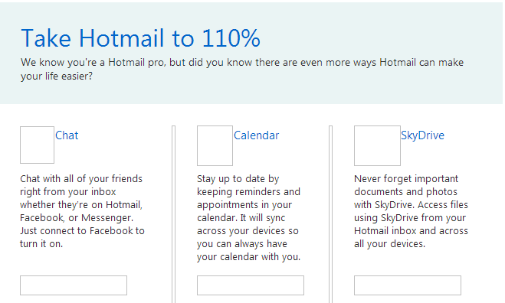
MAKE HOTMAIL WORK FOR YOU

Slide 116
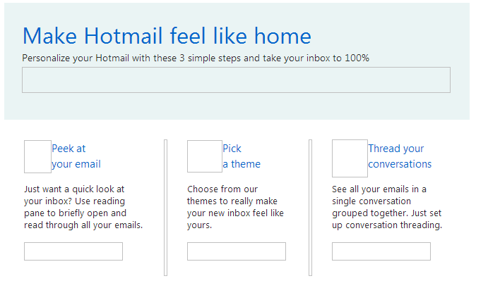
Personalize your Hotmail

Slide 117
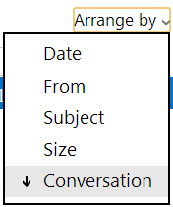
IN OUTLOOK YOU CAN ARRANGE BY

Slide 118
OUTLOOK HAS SKYPE
Microsoft has started to integrate its voice and video calling service, Skype, into its Outlook desktop email client.
A Skype 6.1 update for Windows now includes the ability to call any mobile or landline within Outlook.

Slide 119
Ben’s to do list
#1 email welcome to Hotmail
Put a picture on desktop for them to copy
Send them a many times forwarded email
Send them email with link to website for email help/tips

Slide 120
EMAIL HANDLING OPTIONS
TOP RIGHT OF READING PANE
RIGHT CLICK ON GHOST FLAG FOR DROP DOWN MENU OF OPTIONS TO HANDLE THIS EMAIL

Slide 121
WHAT IS OUTLOOK.COM
Outlook.com is a new free web e-mail service by Microsoft intended to replace Hotmail. Using Outlook.com can be done by creating a new Outlook.com account or upgrading your existing Hotmail account to Outlook.com. If you have used Outlook.com and decided you want to go back to Hotmail, that can be done easily.

Slide 122
Also, downgrading from Outlook.com to Hotmail does not result in loss of data. All your e-mails, contacts, folders, etc. are converted with you. The only thing that changes when going from Outlook.com to Hotmail is the user interface; you get the old Hotmail inbox and features back.

Slide 123
GO TO
IN HOTMAIL/OUTLOOK THERE IS A GO-TO SETTING THAT WILL ALLOW YOU TO PICK A DATE ON THE CALENDAR AND SEE ALL THE EMAILS FOR THAT DAY.

Slide 124
BEFORE DIVING INTO HOTMAIL
Hotmail, or "MSN Hotmail"
Windows Live Hotmail
Windows Live Hotmail Plus
Note: before the class started, Ben sent each of you an email.

Slide 125
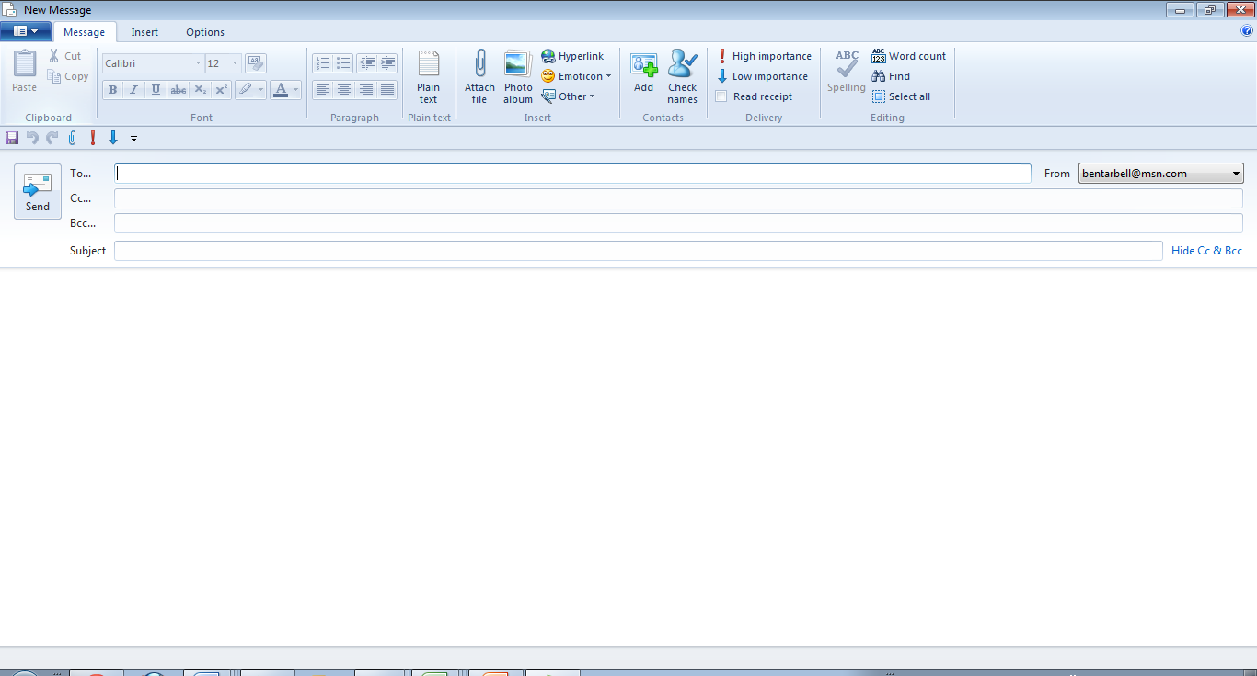
NEED SLIDE ON WINDOWS LIVE HOME SETTINGS

Slide 127
MISCELLANEOUS FEATURES
CALENDAR
SHOW FLAGGED MESSAGES (UNDER QUICK VIEWS)

Slide 128
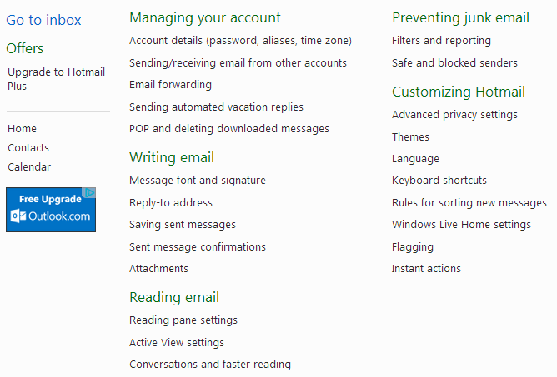
EMAIL OPTIONS

Slide 130
CONTACT LIST OPTIONS CLICK GEAR RIGHT TOP

Slide 131
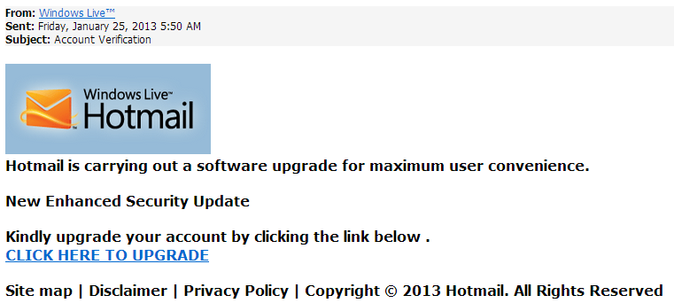
OFFERS TO UPDATE

Slide 132
Tips 1
FILE HOTMAIL EMAILS FASTER
SEARCH: QUICKLY FIND AN EMAIL
FULLVIEW: SHOW CONTENT
MARK AS SAFE (TRUSTED SENDER)
CONVERSATIONS: GROUP TOGETHER EMAILS SENT WITH SAME SUBJECT LINE

Slide 133
Tips -2
REVERSE THE CURRENT EMAIL SORT ORDER IN HOTMAIL
HOW TO HIDE OR REMOVE THE ADS
AUTOMATICALLY MOVE EMAIL TO FOLDERS
DIFFERENT GROUP SORTS AVAILABLE
YOU CAN SHRINK THE FOLDER SCREEN

Slide 134
TIPS -3
OPEN AN EMAIL IN PRINT PREVIEW MODE (LETS YOU READ BEFORE YOU PRINT)

Slide 135
WHERE ARE SLIDES OF UNDISCLOSED RECIPIENTS?

Slide 136
RECALLING A HOTMAIL EMAIL
And If you're using Live Mail 2011, please follow the steps below: 1. Start Live Mail. 2. Then create a new e-mail message, on the Windows Live Mail toolbar, click New. 3. In the message window, click the Delivery, and then check the box Read receipt.

Slide 138
WHEN YOU CLICK THE “TO” BOX THE CONTACT LIST OPENS UP.

Slide 139
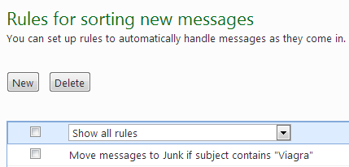

Slide 140
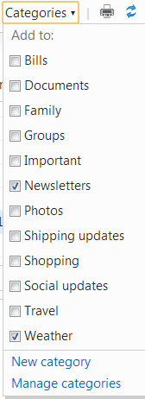
EMAIL “CATEGORIES” OPTIONS

Slide 141
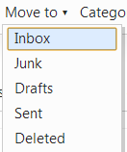
EMAIL “MOVE TO” OPTIONS

Slide 142
MARKING AN EMAIL

Slide 143
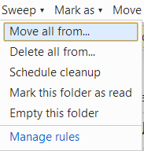
SWEEP OPTION

Slide 144
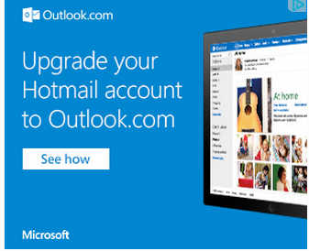
AUTOMATIC PROMPTS

Slide 145
HOTMAIL EMAIL “MOVE TO” OPTIONS
AFTER CLICKING ON EMAIL

Slide 146
TOOL BAR CONTAINS OPTIONS TO DEAL WITH AN OPEN EMAIL

Slide 147
MORE EMAIL HANDLING OPTIONS CLICK DOWN ARROW AFTER REPLY

Slide 148
HOVER YOUR MOUSE OVER THE SHADOW ITEMS ON A MESSAGE
[The envelope]= Mark as Read/Unread (can mark without opening it)
The “X”: Delete this message -Can delete without opening it)
The “flag”: Keep this message at the top of your inbox so you can keep track of it and act on it later) (Flagged emails can be hidden)

Slide 149
OPEN EMAIL ACTION BUTTONS SHOWN IN PREVIEW PANE RIGHT HAND SIDE UNDER TIME OR DATE
HOVER MOUSE OVER FLAG TO ACTIVATE GHOST IMAGES
HOVER MOUSE TO SEE WHAT EACH GHOST IMAGE DOES
ENVELOPE WILL MARK UNREAD
“X’ WILL DELETE
CLICK FLAG TO ACTIVATE

Slide 150
READING PANE OPTIONS SETTINGS (upper right hand corner of screen under your name)

Slide 151
USING THE INBOX FEATURES BAR

Slide 152
TODAY’S VERSION OF HOTMAIL.COM

Slide 153
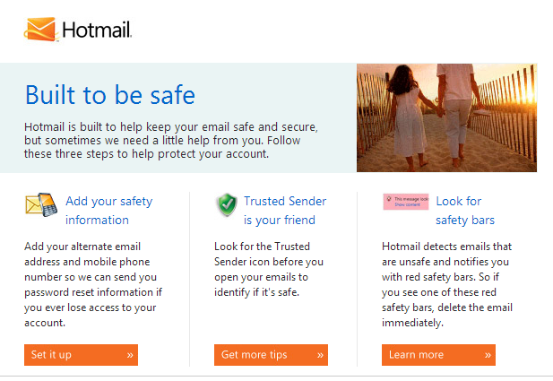
HOTMAIL BUILT TO BE SAFE

Slide 155
USING TOOLBAR FEATURES
All will show all emails (probably default)
Unread will show unread emails ONLY
Contacts will show the emails from people in your contact list
Social Updates will show you emails from Facebook, Twitter, Linkedin, etc.
Groups will show contacts you have put together for email groups
Newsletters show items from news sources
Everything Else shows rest

